Slide 1
Digital Portfolio
STUDENT NAME: B. Sree Vethya
REGISTER NO AND NMID: 2428A0007 & as2428a0007
DEPARTMENT: B.Sc DCFS
COLLEGE: Cheran Arts Science College

Slide 2
PROJECT TITLE
Smart Age Calculator Web App

Slide 3


AGENDA
Problem Statement
Project Overview
End Users
Tools and Technologies
Portfolio design and Layout
Features and Functionality
Results and Screenshots
Conclusion
Github Link
3/21/2024 Annual Review

Slide 4

PROBLEM STATEMENT
🧩 Problem Statement :
Many users struggle to calculate their exact age — not just in years, but also in months and days. Additionally, remembering birthdays and tracking upcoming ones can be tedious. This project solves that by offering a clean, interactive web app that calculates age precisely, greets users on their birthday, and shows a countdown to their next one.

Slide 5

PROJECT OVERVIEW
📌 Project Overview:
Smart Age Calculator is a responsive, browser-based application built using HTML, CSS, and JavaScript. It allows users to input their birthdate and instantly view their age in years, months, and days. The app also stores the birthdate locally, greets users on their birthday, and shows how many days are left until their next birthday. A reset option lets users clear their data and start fresh.

Slide 6

WHO ARE THE END USERS?
👥 End Users:
General users who want to calculate their age quickly and accurately
Parents tracking their children's age milestones
Event planners managing birthday reminders
Students and learners exploring date manipulation and DOM interaction in JavaScript

Slide 7

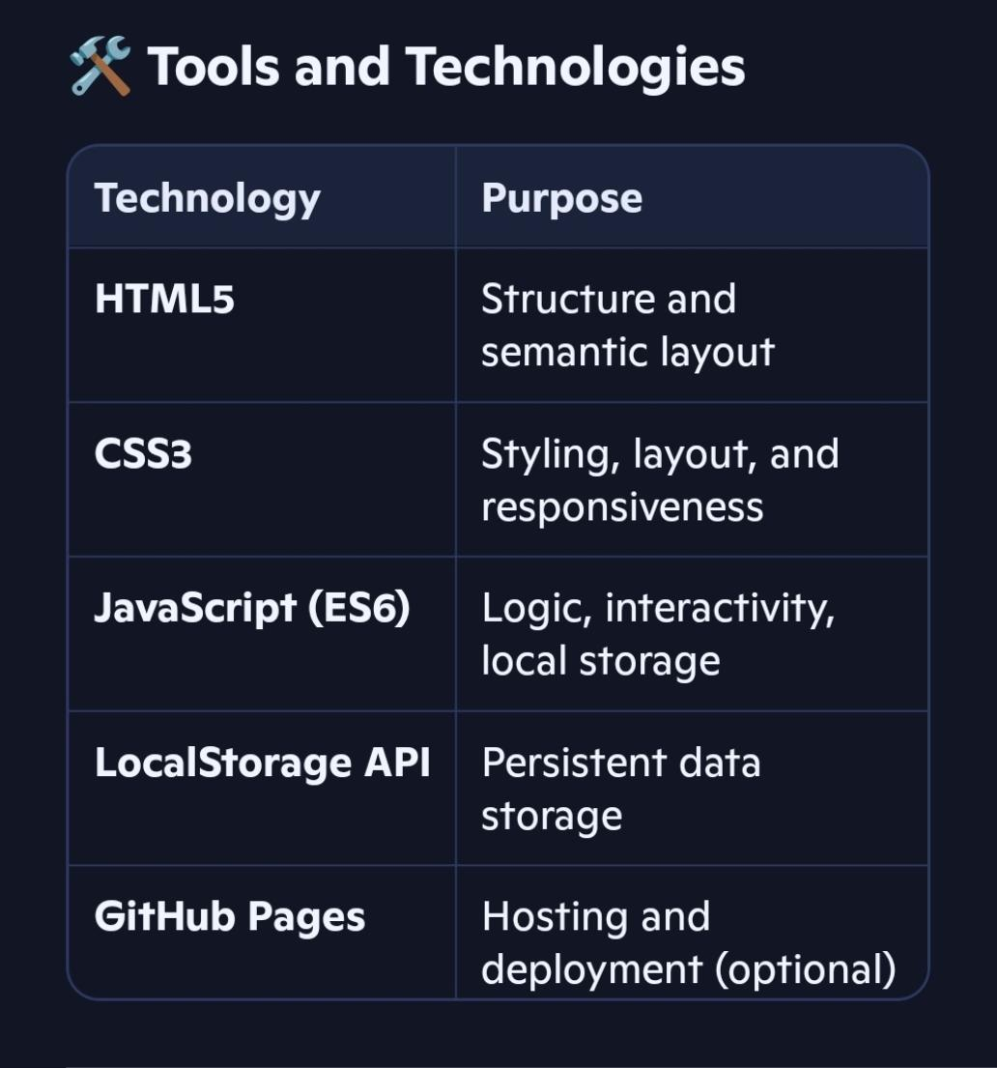
TOOLS AND TECHNIQUES

Slide 8
POTFOLIO DESIGN AND LAYOUT
🎨 Portfolio Design and Layout:
Minimalist card layout with centered content
Responsive design for mobile and desktop
Accessible form elements with labels and ARIA attributes
Color palette: Soft teal and white for a clean, calming interface
- Typography: Segoe UI for readability and modern feel
‹#›

Slide 9
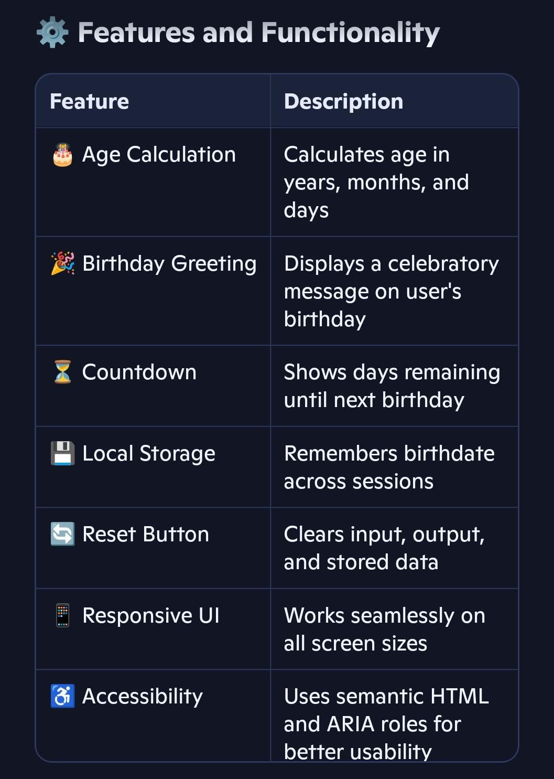
FEATURES AND FUNCTIONALITY

Slide 10
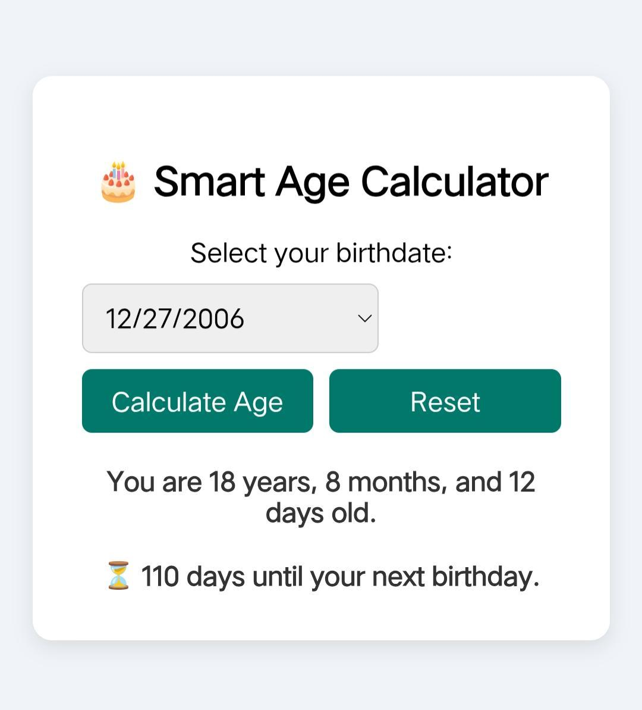

RESULTS AND SCREENSHOTS
3/21/2024 Annual Review
‹#›

Slide 11
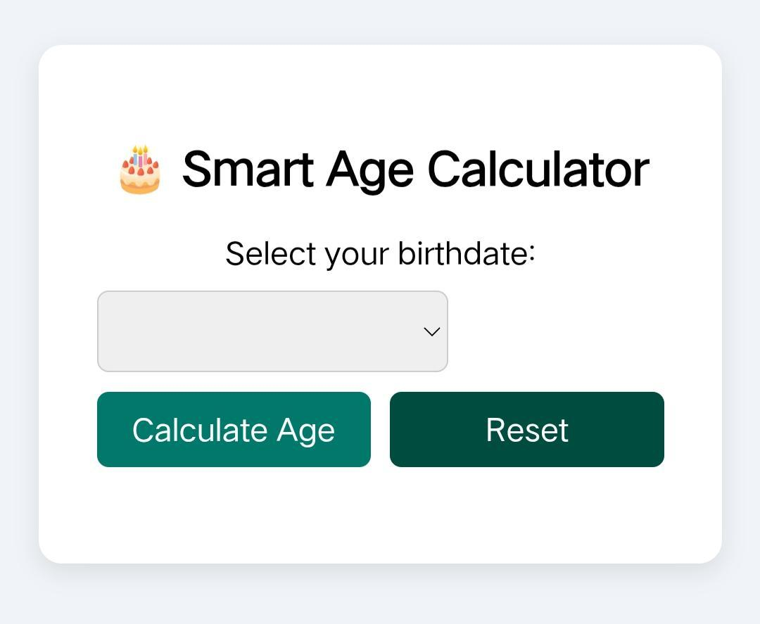
RESULTS AND SCREENSHOTS
3/21/2024 Annual Review
‹#›

Slide 12
CONCLUSION
🧾 Conclusion:
The Smart Age Calculator is a polished, user-friendly web app that demonstrates your ability to:
Solve real-world problems with code
Build responsive, accessible interfaces
Use JavaScript for dynamic functionality and data persistence
Design clean, professional layouts with CSS
Think like a product developer, not just a coder
This project is a strong addition to your portfolio and a great talking point in interviews or tech communities.
‹#›

